Slide 1
A DEEP DIVE INTO DARK DECADE OF MANCHESTER UNITED

Slide 2

DATA VIZUALIZATIONS IN FOOTBALL
Data visualization is the process of translating large data sets and metrics into charts, graphs and other visuals.
In football, it has many applications right from detecting a small flaw in a player’s technique to devising game-plans to outsmart an opponent and expose his weakness.
Nowadays with advanced and complex metrics like xG, xThreat and Shot Creating Actions (SCA) one micro-analyse and break down a game far efficiently.
VIZUALIZATION COVERED IN THIS PROJECT
Pizza Plot
Bumpy
Scatter Plot
Swarm Plot
Radar Plot
Squarify Plot

Slide 3
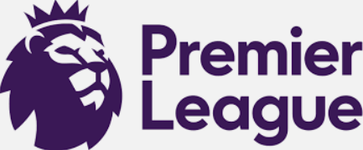
COMPETITIONS COVERED
WHY PREMIER LEAGUE?
The Premier League is played in a round-robin format where 20 teams face each other twice in a home-away format.
Tournaments like UEFA Champions League play group stage and then a knockout format thereafter. Teams from lower ranked European leagues qualify for it as well which means data could be highly inconsistent depending on the strengths of these team
Domestic Cup like FA Cup and League Cup play knockout format as well where teams belonging to as low as tier 10 participate

Slide 4

DATASETS
There are few sites that process free access to football data like Understat.com, Fbref.com etc
For this project the datasets used are from Fbref.com – as it provides access to advanced metric like xG
Also the scope to provide clean datasets helps in the visualization process

Slide 5
2012-2013

Slide 6
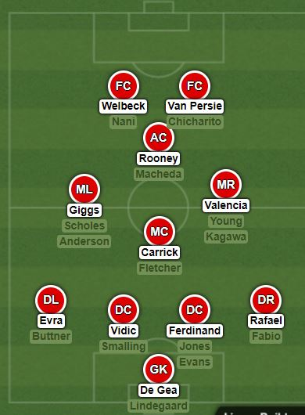
2012-2013
Squad
Transfer IN Transfer OUT
Robin Van Persie Dimitar Berbatov
Shingi Kagawa Ji Sung Park
Federico Macheda
Ahead of the legendary manager Sir Alex Ferguson’s final season, Man Utd saw the arrival of Robin Van Persie arch-rivals Arsenal and Shingi Kagawa with the former being instrumental in Man Utd’s title charge. Man Utd predominantly used the 4-3-1-2 formation with success as they won PL for the 20th time

Slide 7
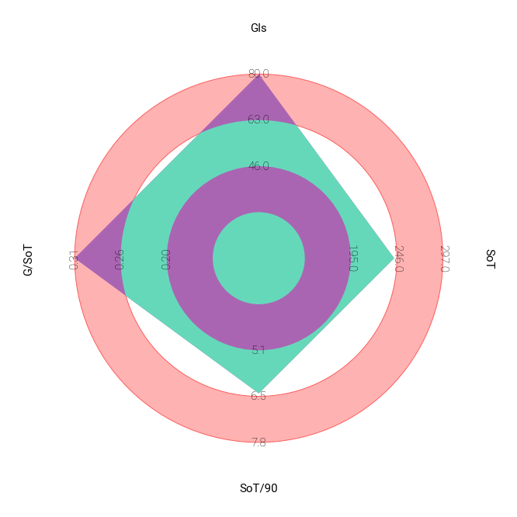
2012-2013
SHOTS
Under Sir Alex Ferguson’s final season Manchester United dominated when it came to goals scoring and being efficient in front of goal. United led the charts when it came to Goals Scored(80) and Goals/SoT(0.31)

Slide 8
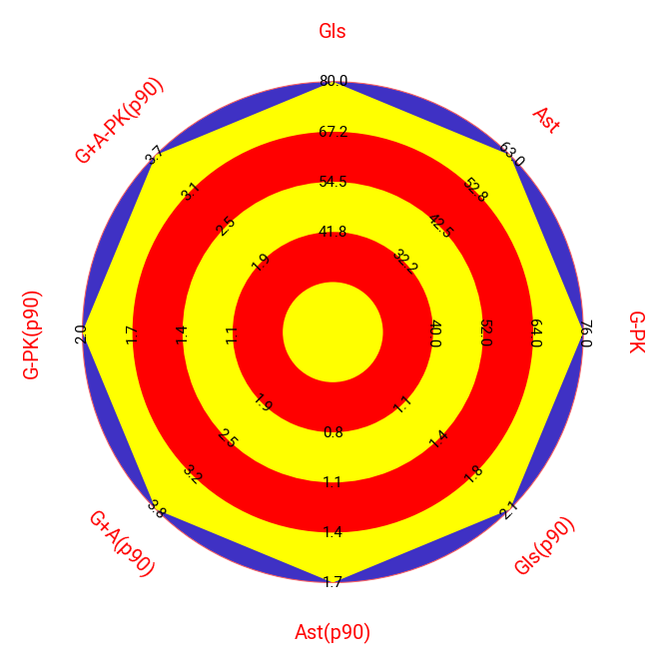
2012-2013
MISCELLANOUS
Manchester United dominated each and every metric when it came to Goal Scoring and Assists. They were ruthless in front of the goal.

Slide 9
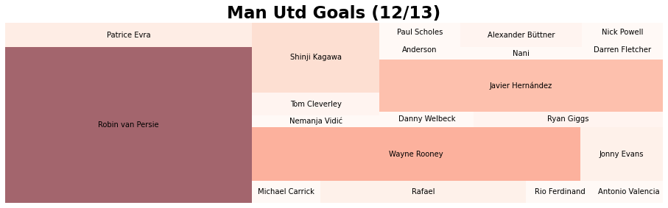
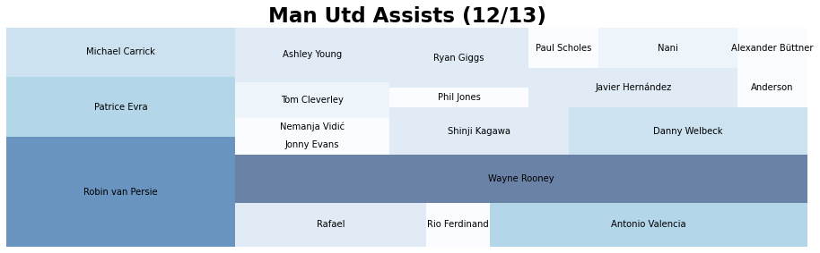
2012-2013
CONTRIBUTION
Manchester United signed Robin Van Persie from fellow rivals Arsena lwho was instrumental for the title win. He scored 26 goals and ended up being top goal-scorer in PL that season. He was ably backed by Wayne Rooney (12) and Javier Hernandez(10).
Wayne Rooney (10) topped the charts for assists, with Robin Van Persie (9) again proving pivotal in this department as well. Patrice Evra (5) , Antonio Valencia (5) and Micheal Carrick(4) proved to be the perfect foil for the duo

Slide 10
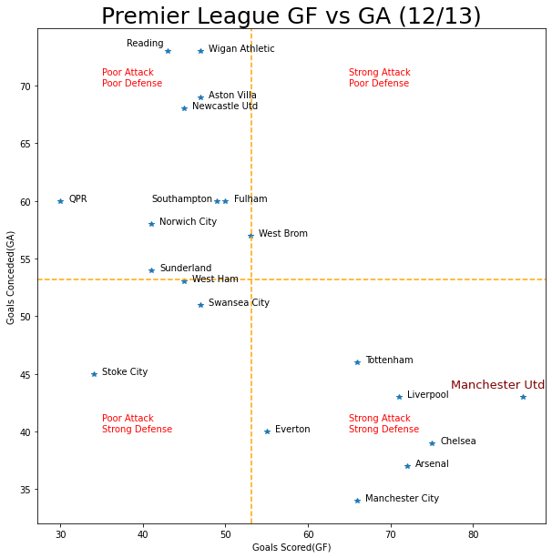
2012-2013
DEFENCE
Manchester United scored the most goals in PL and ended up racking 86 goals. When it came to defence United conceded the fifth least goals in PL(43) with PL runner ups Manchester City topping this metric with 34. The cracks were starting to appear as United needed to replace the ageing and declining defenders for next season.

Slide 11
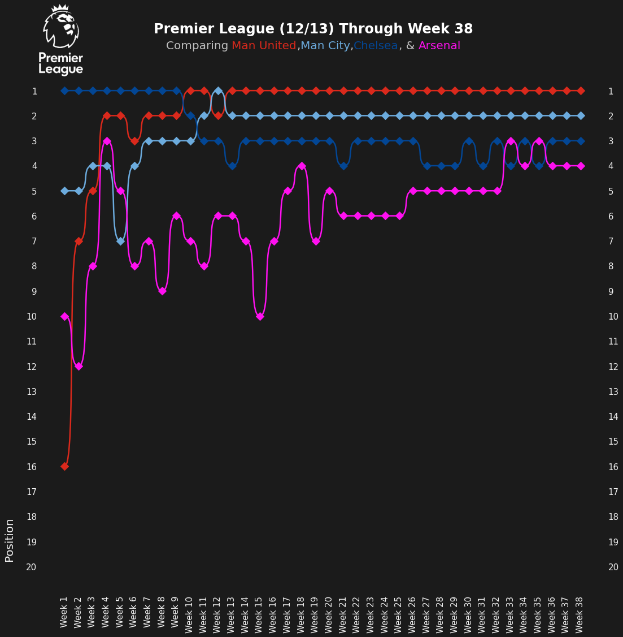
2012-2013
STANDINGS
Manchester United started the season with loss but recovered in due time to comfortably see out the challenge from Manchester City. Manchester United won the league with a 11 point gap over Man City.

Slide 12
2013-2014

Slide 13
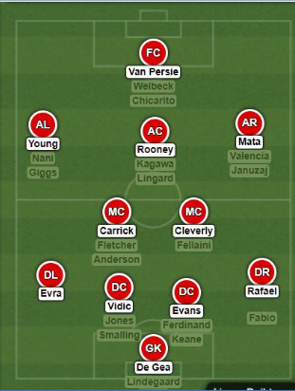
2013-2014
Squad
Transfer IN Transfer OUT
Marouane Fellaini Fabio(loan)
Juan Mata (Jan) Anderson(loan)
David Moyes saw the arrival of Marouane Fellaini and Juan Mata (in January window) and pretty much inherited the same team from the previous season. He preferred the 4-2-3-1 formation

Slide 14
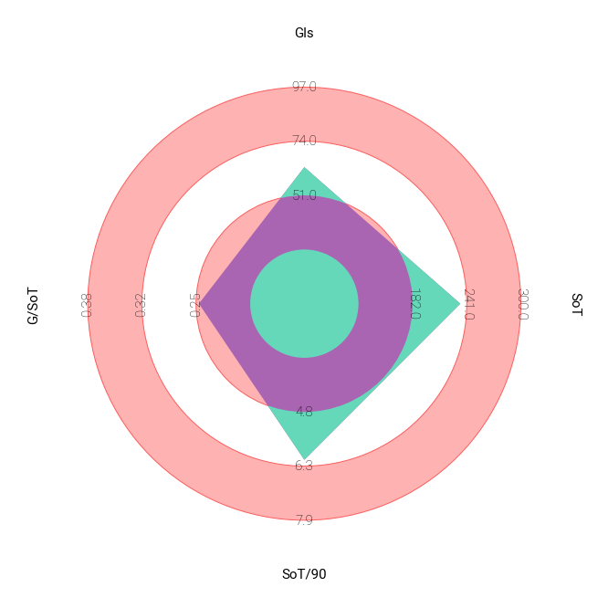
2013-2014
SHOTS
David Moyes the subsequent successor of Sir Alex Ferguson led Manchester United in 2013/14. Manchester United were under-par throughout the season. They relied heavily on Wayne Rooney(17) and declining Robin Van Persie(12) for scoring goals. They only scored 64 goals which was 23 goals less than Man City(97). They only converted 0.25 Goals/SoT

Slide 15
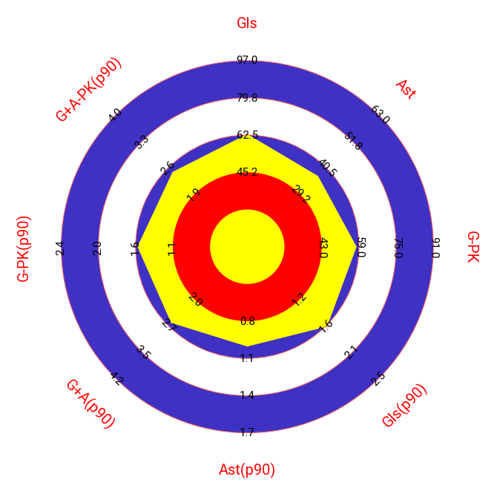
2013-2014
MISCELLANOUS
Man United were below average when it came to Goal creation and scoring. The heavy reliance on Wayne Rooney (17 Goals, 12 assists) and Juan Mata (6 goals, 4 assists) after the Spaniard was signed in January to save a faltering season. United had recorded underwhelming figures of 1.6 Goals /90 and 0.9 assists/90.

Slide 16
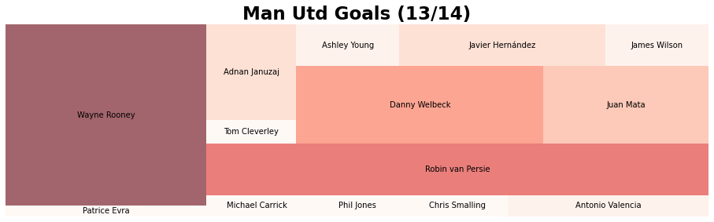
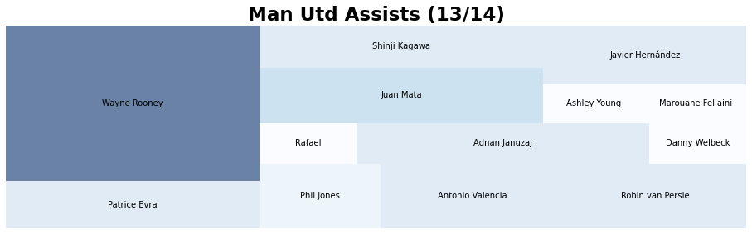
2013-2014
CONTRIBUTION
Manchester United relied heavily on Wayne Rooney(17) when it came to scoring goals and to some extent on Robin Van Persie(12), Juan Mata(9)
When it came to creating chances Wayne Rooney(12) again played an crucial role with Juan Mata(6) proving to be a perfect foil after being signed in January and only featuring in 15 games.

Slide 17
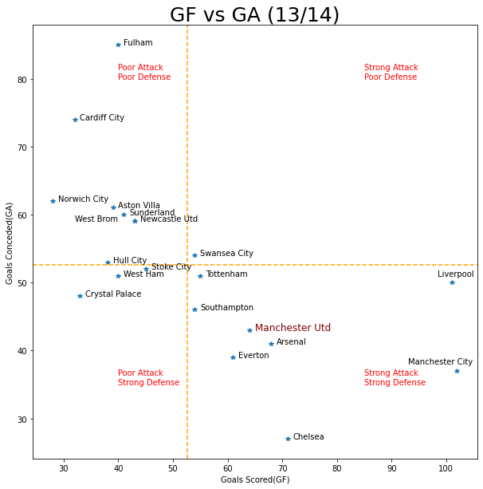
2013-2014
DEFENCE
Man Utd conceded the 5th least goals in PL – 43 and scored the 5th most goals in PL- 64 but were way behind eventual PL winner Man City and PL runner ups who scored 102 and 101 goals respectively.

Slide 18
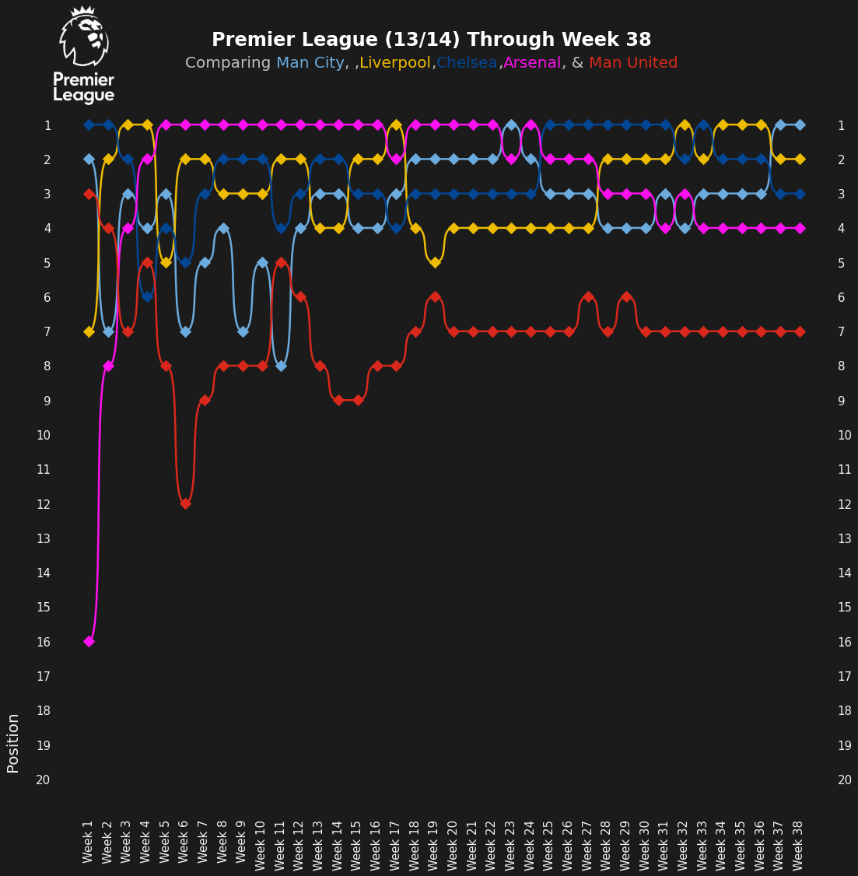
2013-2014
STANDINGS
Manchester United struggled to get going since the start of the PL as barely managed to break into top 6 to get a UEFA Europa League spot. David Moyes team ended 7th and that eventually led to his sacking. Louis Van Gaal was appointed as his sucessor.

Slide 19
2014-2015

Slide 20
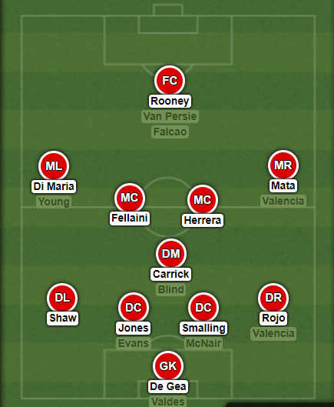
2014-2015
Squad
Transfer IN Transfer OUT
Angel Di Maria Danny Welbeck
Radamel Falcao Shingi Kagawa
Luke Shaw Nani (loan)
Ander Herrera Hernandez(loan)
Marcos Rojo Tom Cleverley (loan)
Daley Blind Patrice Evra
Louis Van Gaal took over the reign and oversaw some massive changes in the summer. He initially used the 3-5-2 formation which was successfully implemented by his Netherlands team in WC 2014 but Man Utd strugged with heavy midfield possession based system before switching to 4-1-4-1 formation

Slide 21

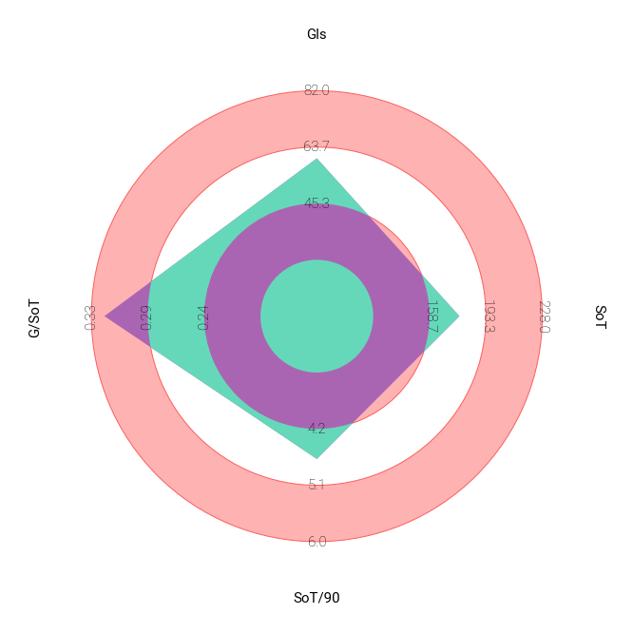
2014-2015
SHOTS
After Louis Van Gaal took over Man Utd became a possession oriented team. Although that also meant they didn’t attempt much to score goals due lack of goalscorers. Having a below average attempt of 177 Shots of Target (SoT) and 4.66 SoT/90. The efficiency of Robin Van Persie (10) and Wayne Rooney(12) upfront meant Man Utd a second best team for Goals/SoT(0.32).

Slide 22
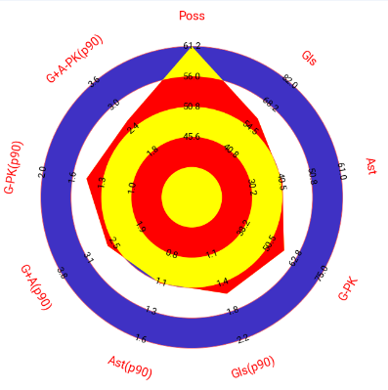
2014-2015
MISCELLANOUS
Man Utd were the best team in terms of possession (61.2%) but that didn’t convert to being a high scoring team. Despite being efficient in front of goals the lack of chance creation meant Manchester United scored only 60 goals.

Slide 23
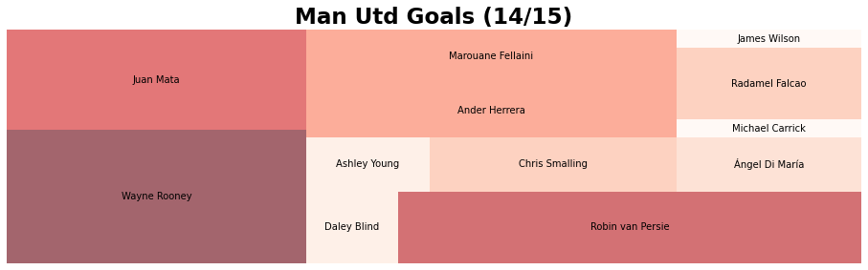
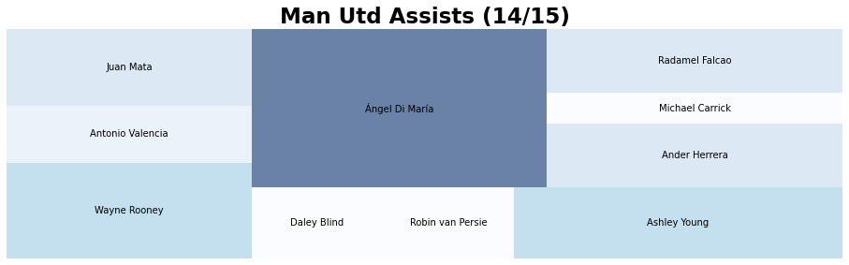
2014-2015
CONTRIBUTION
Manchester United relied heavily on Wayne Rooney(12) and Robin Van Persie(10) when it came to scoring goals.
When it came to creating chances Angel Di Maria(10) topped the charts for It with Wayne Rooney(5), Ashley Young (5) and Juan Mata(4) being the other contributors.

Slide 24
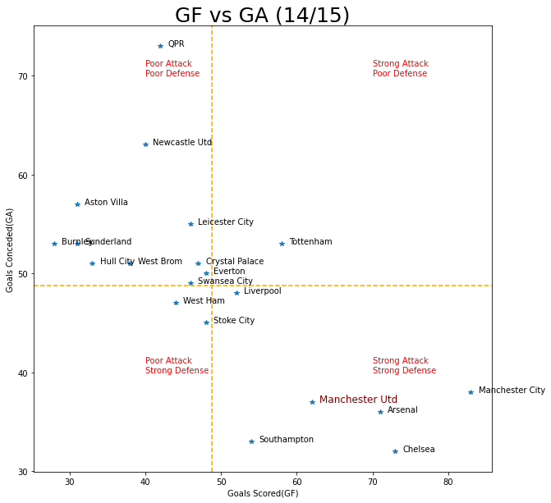
2014-2015
DEFENCE
Man Utd conceded the 4th least goals in PL, 3 more than PL winners Chelsea – 35. Despite scoring 4th most goals in PL (62) it was no way near the likes of Chelsea (73) and runner ups Man City(83).

Slide 25
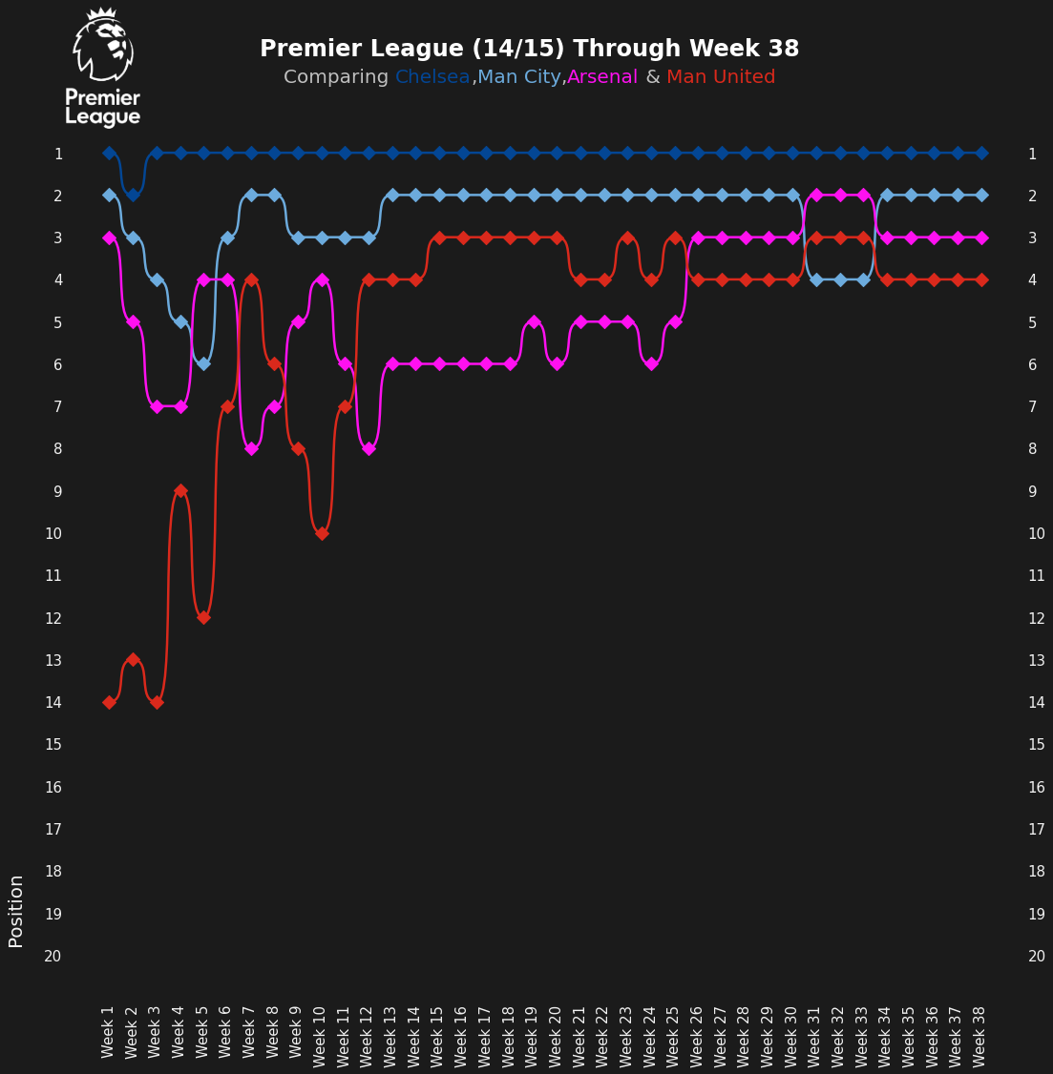
2014-2015
STANDINGS
Despite a shaky start to the season Man Utd recovered from it to eventually to finish 4th and bagged the UEFA Champions League qualification

Slide 26
2015-2016

Slide 27
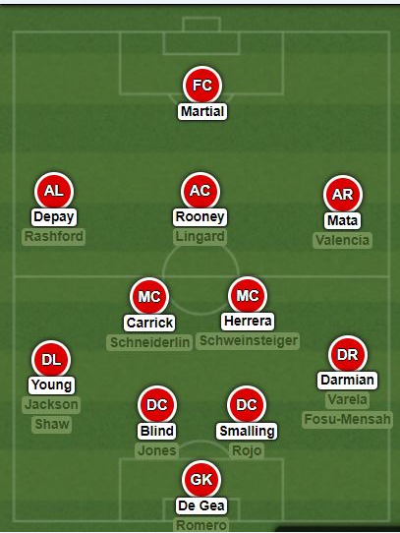
2015-2016
Squad
Transfer IN Transfer OUT
Anthony Martial Robin Van Persie
Morgan Schneiderlin Nani
Memphis Depay Angel Di Maria
Bastian Schweinsteiger Javier Hernandez
Matteo Darmian Rafael
Louis Van Gaal made some changes and cleared out aging players and bought in aforementioned players. He switched to a 4-2-3-1 formation.
.

Slide 28
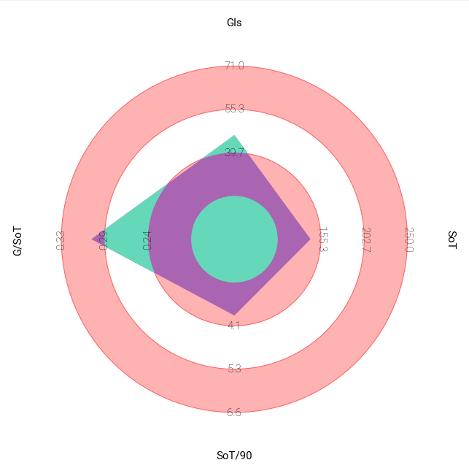
2015-2016
SHOTS
Man Utd lack of emphasis of attempting for goals and scoring what led to their downfall this season. They scored a meagre 49 goals that season.

Slide 29
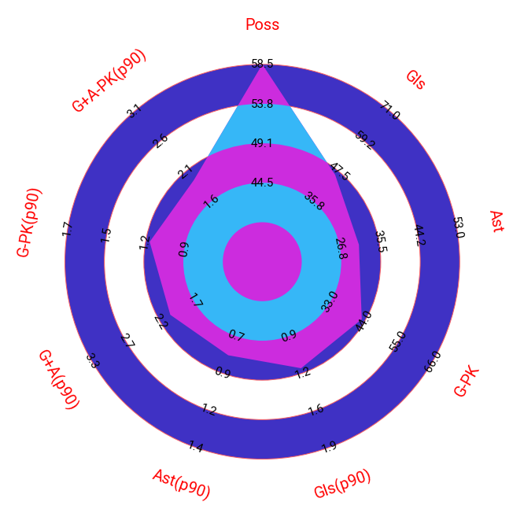
2015-2016
MISCELLANOUS STATS
Louis Van Gaal’s philosophy of possession based football didn’t really pay dividends. As they were the highly ranked team when it came to possession but being below average in creating/scoring quality goals was something which was evident throughout the season

Slide 30
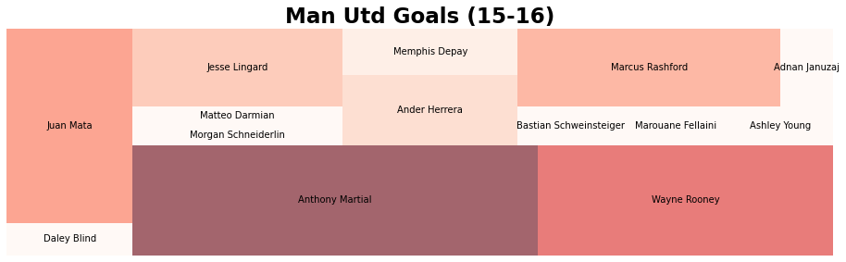
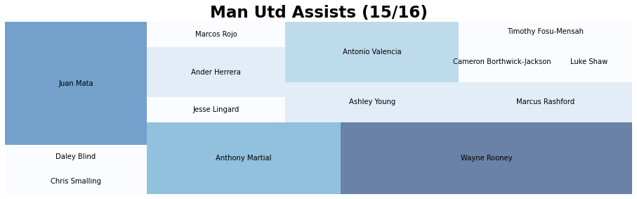
2015-2016
CONTRIBUTION
Teenage sensation Anthony Martial topped the scoring charts scoring 11 goals along with Wayne Rooney (8) and Juan Mata (6)
When it came to creating chances and laying it off for the goalscorer the same trio enjoyed the success - Wayne Rooney (6) , Juan Mata (5) and Anthony Martial (4)

Slide 31
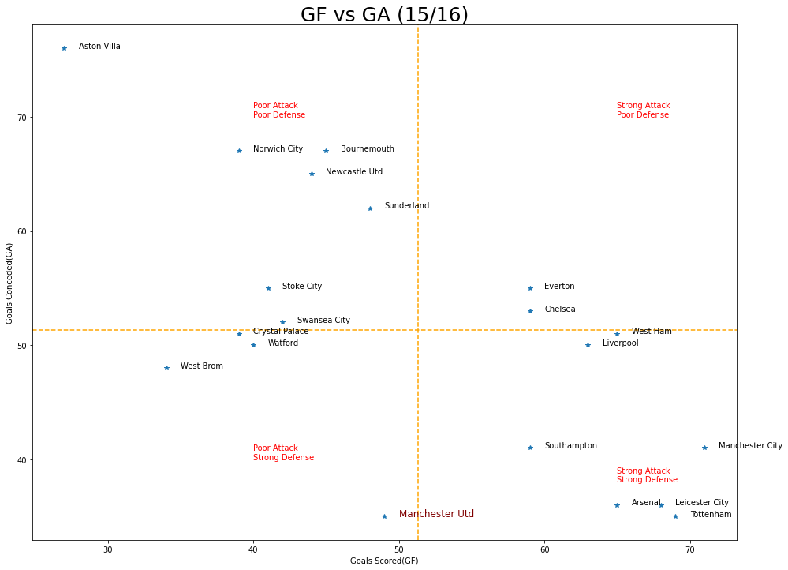
2015-2016
DEFENCE
Man Utd conceded the joint least goals along with Tottenham – 35. The defensive solidity wasn’t translated in the other end as they were below par when it came to scoring goals as they ended the the season registering only 49 goals well below the PL average

Slide 32
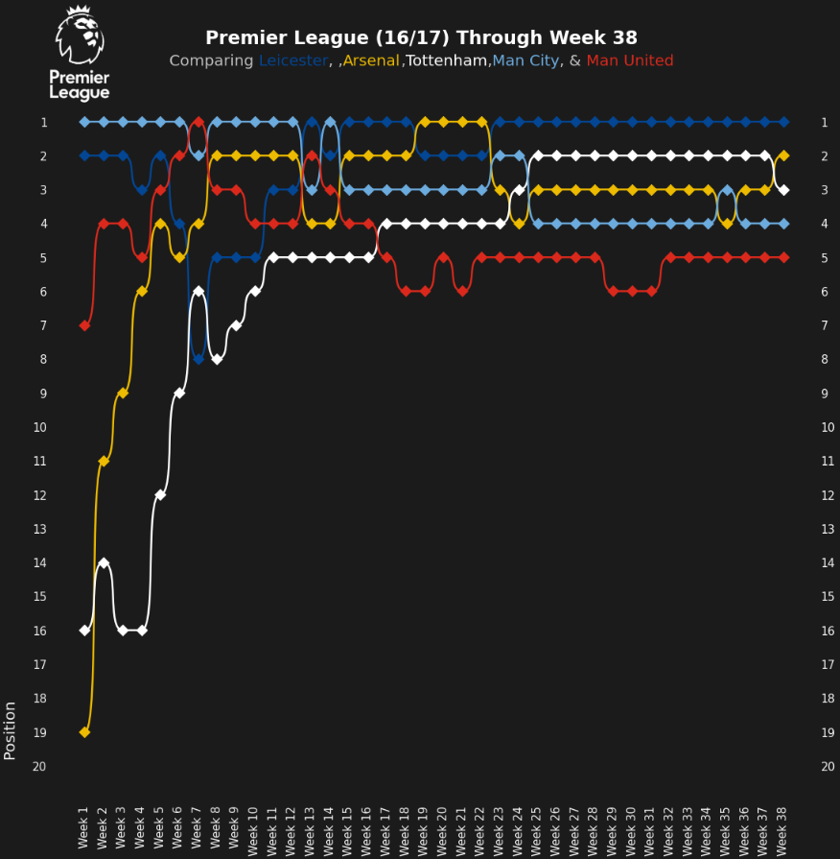
2015-2016
STANDINGS
Man Utd continued to struggle with Louis Van Gaal’s as the lack of pressing from the team and tactical instruction against a quick counter attack whenever there was an opportunity to priortise possession of the ball, ultimately led to Louis Van Gaal’s downfall.
Man Utd struggled to get into top 4 and ultimately finished 5th leading to missing out on a UCL spot and the sacking of Louis Van Gaal

Slide 33
2016-2017

Slide 34
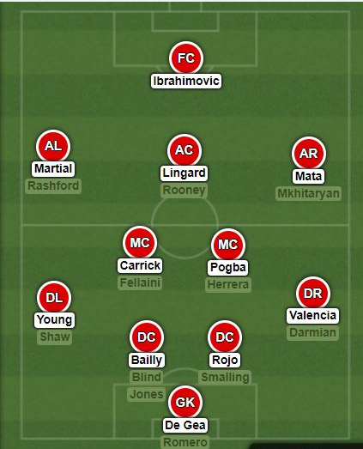
2016-2017
Squad
Transfer IN Transfer OUT
Paul Pogba Morgan Schneiderlin
Zlatan Ibrahimovic Bastian Schweinsteiger
Eric Bailly Memphis Depay
Henrikh Mkhitaryan Paddy McNair
Jose Mourinho was given the charge and he bought in veteran striker Zlatan Ibrahimovic and broke the transfer record for Paul Pogba, with Eric Bailly and Henrikh Mkhitaryan being an addition in attack and defence respectively. Man Utd predominantly setup in 4-2-3-1 formation this season.

Slide 35
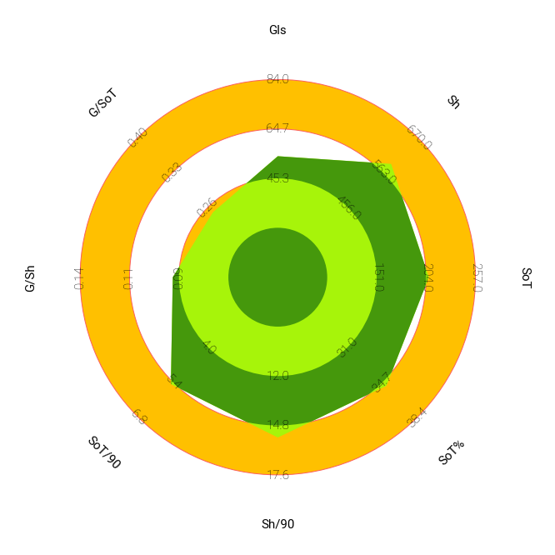
2016-2017
SHOTS
Man Utd were below average when it came to scoring goals. They scored only 54 goals while PL winners Chelsea had scored 85 goals

Slide 36
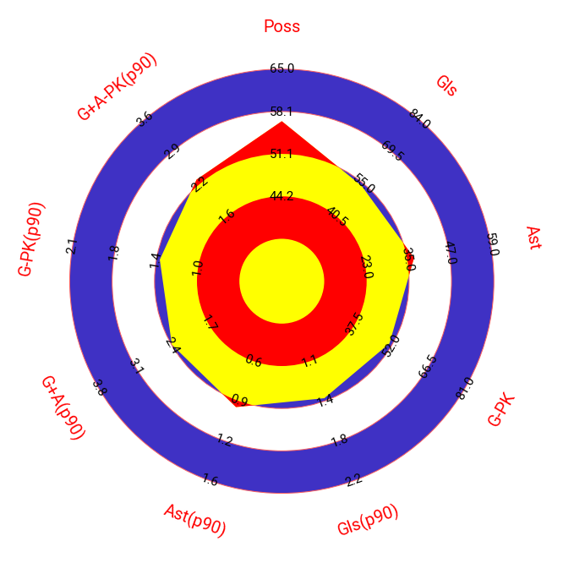
2016-2017
MISCELLANOUS STATS
Man Utd were an average team when it came to Goals scoring and Creation

Slide 37
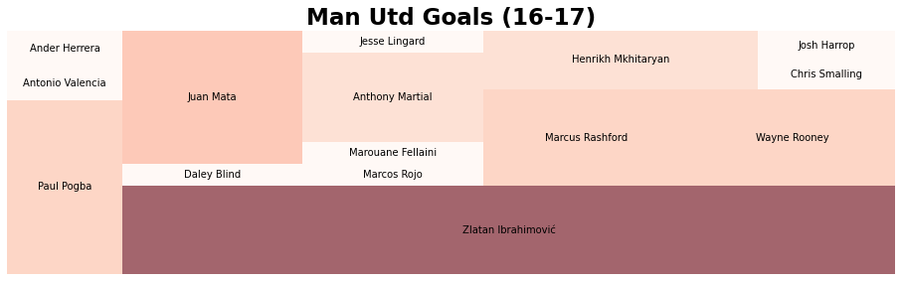
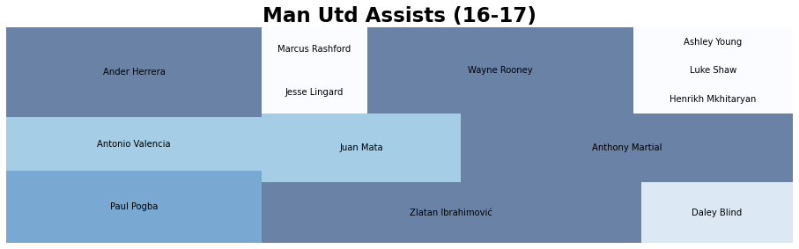
2016-2017
CONTRIBUTION
Zlatan Ibrahimovic was heavily involved when it came to goal scoring and chance creation. On creation front Ander Herrera, Wayne Rooney, Anthony Martial and Paul Pogba were heavily involved.

Slide 38
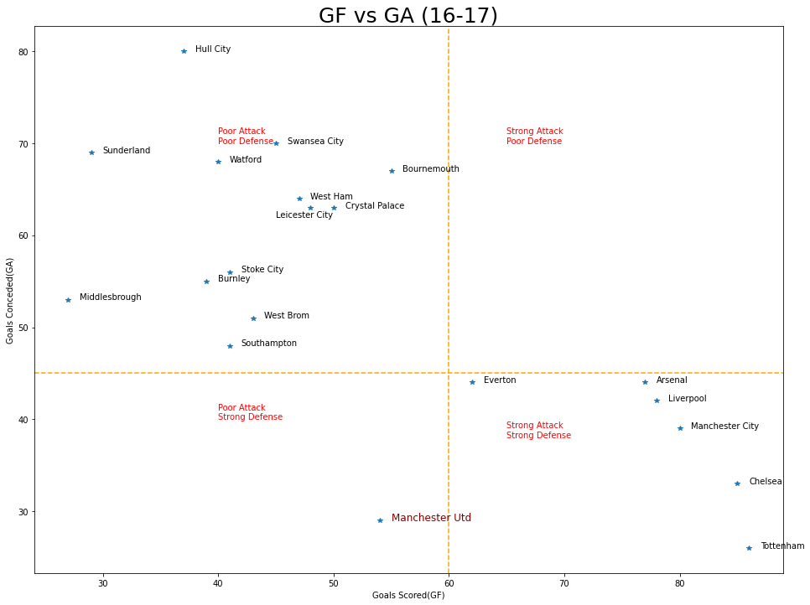
2016-2017
DEFENCE
Jose Mourinho’s pragmatic approach helped Man Utd to conceded second least goals (29) behind PL runner ups Tottenham (26) and just ahead of PL winners Chelsea (33). That approach also meant they didn’t really score a lot of goals and were well below the PL average.

Slide 39
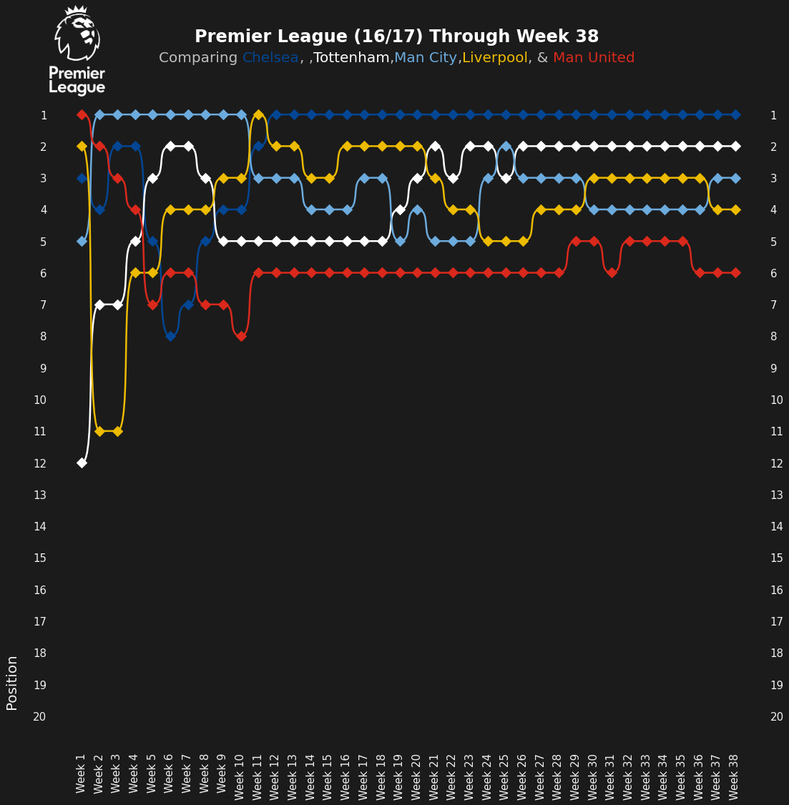
2016-2017
STANDINGS
Man Utd season never really kicked off as they battled hard to get into top 4 to get Champions League Football. Jose Mourinho eventually ditched the PL top 4 pursuit towards the end and gave more emphasis on winning the Europa League to qualify for Champions League

Slide 40
2017-2018

Slide 41
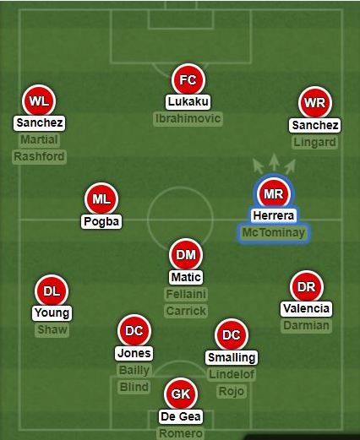
2017-2018
Squad
Transfer IN Transfer OUT
Romelu Lukaku Wayne Rooney
Alexis Sanchez Henrikh Mkhitaryan
Nemanja Matic Adnan Januzaj
Victor Lindelof
In his second season the Portuguese bought in Romelu Lukaku, Alexis Sanchez to add steel to replace the aging stars in Zlatan Ibrahimovic and Wayne Rooney. The experienced campaigner Nemanja Matic was bought from Chelsea to fill Micheal Carrick’s shoes. Mourinho shifted between 4-2-3-1 and 4-3-3 formation

Slide 42
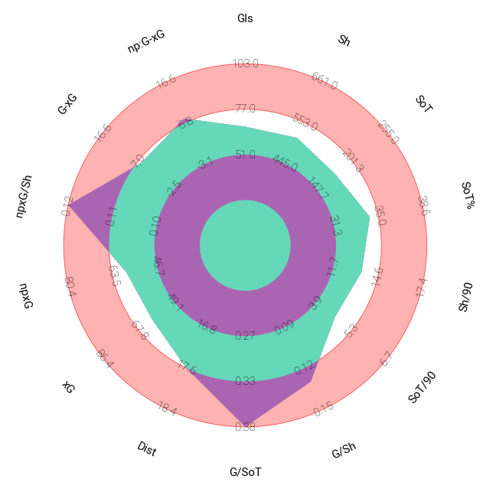
2017-2018
SHOTS
Man Utd were quite efficient when it came to scoring goals as they were highest ranked team when it came to npxG/Sh and Goals/SoT. They were average but very efficient when it came to scoring this season which highlights the manager Jose Mourinho’s pragmatic approach

Slide 43
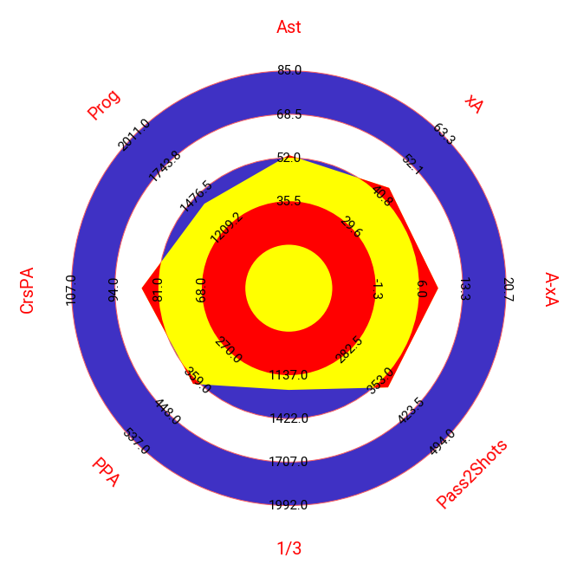
2017-2018
PASSING
More emphasis was giving on crossing the ball from flanks as we can see from the CrsPA(Crosses into 18 yrd box). Man Utd were average when it came to every aspect on chance creation which again highlights Jose Mourinho’s pragmatic approach

Slide 44
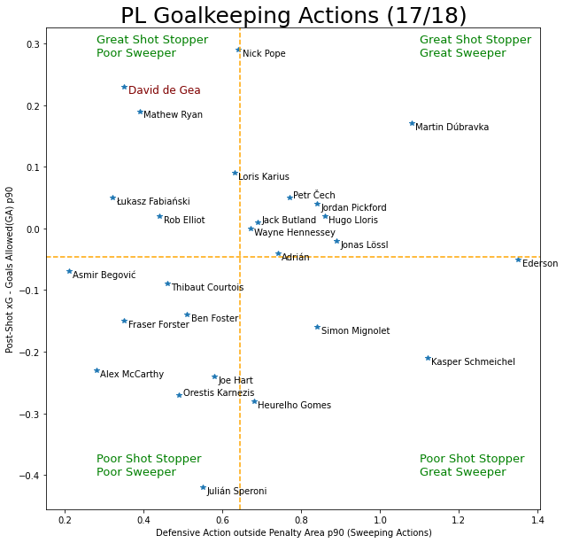
2017-2018
GOALKEEPING
David De Gea produced one of the greatest GK season ever. Mourinho’s pragmatic approach meant Man United conceded a lot of shots. Thanks De Gea Man Utd were able to see out lot of games and win games a goal’s margin

Slide 45
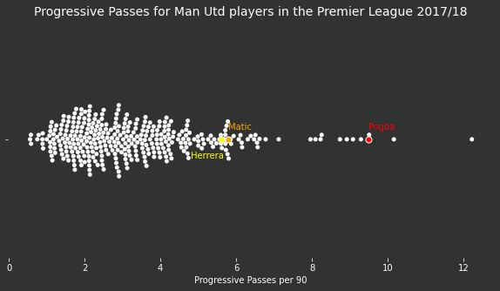
2017-2018
Progressive Passing
Pogba (7.84) saw his resurgence under Solskjaer being best progressive passer at Utd and 5th best in the league. Shaw and Matic finsihed behind him with 6.04 and 5.31 passes/90 resp.

Slide 46
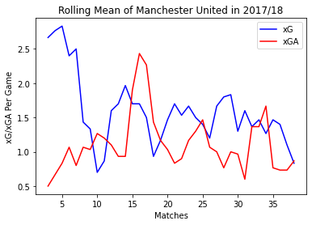
2017-2018
Rolling Mean- xG v xGA
Manchester United had a brilliant start to the season but the pragmatic approach always meant xG and xGA oscillated sharply throughout the season. Despite continuing with the highly unsustainable approach Jose Mourinho led Man Utd to a 2nd place finish ,19 points off the top

Slide 47
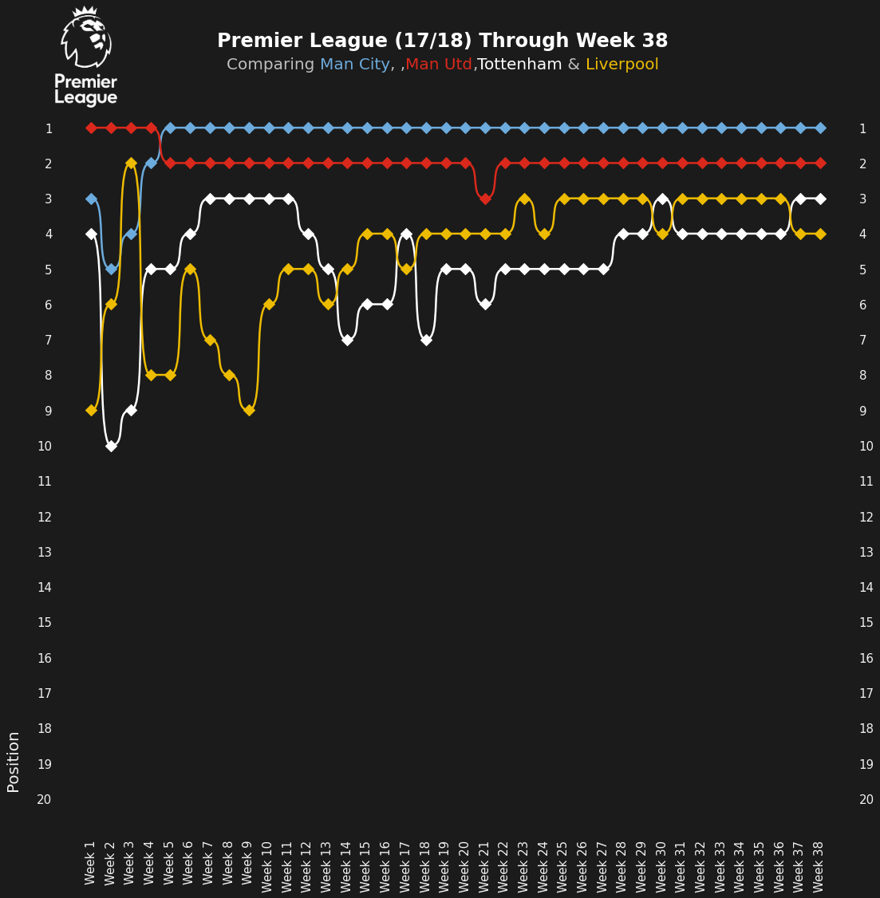
2017-2018
STANDINGS
Manchester United had a brilliant start to the season but the eventual winners Manchester City ran away with season. Man Utd managed to finish 2nd thanks to the instability at the other rivals clubs like Chelsea and Tottenham

Slide 48
2018-2019

Slide 49
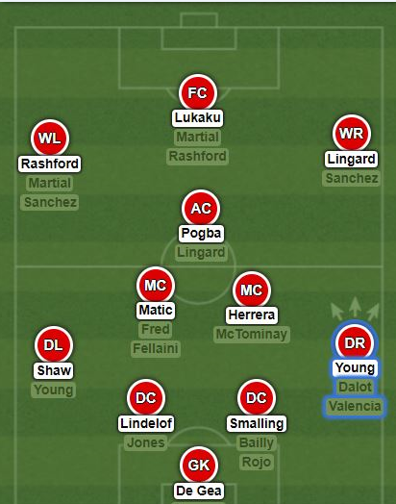
2018-2019
Squad
Transfer IN Transfer OUT
Fred Daley Blind
Diogo Dalot Marouane Fellaini
Lee Grant
In a frustrating summer window Man Utd only brought in Fred and Diogo Dalot for first team but they both struggled to match the intensity of PL in this season. Despite wanting a CB Jose Mourinho was denied to sign one by the board.The fall out with certain players meant the formation was tweaked a lot before he was sacked in December. Ole Gunnar Solskjaer took the interim charge and predominantly settled with 4-2-3-1 with subtle tactical tweaks in some games.

Slide 50
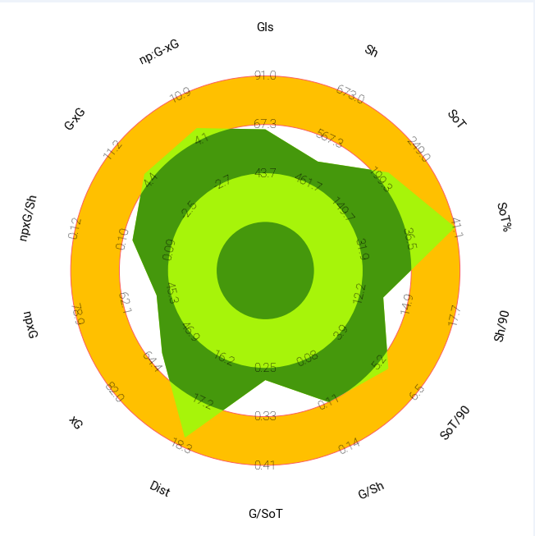
2018-2019
SHOTS
The appointment of Solksjaer midway into the season led United to attack with more freedom and that led to topping SoT% metric. Utd became one best teams when it came to covering Distances.

Slide 51
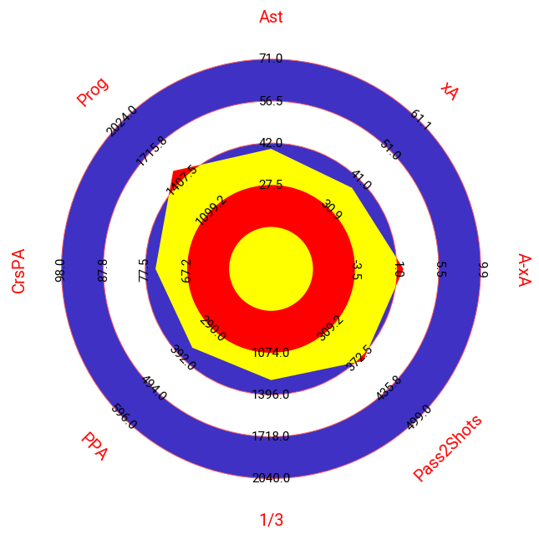
2018-2019
PASSING
There weren’t significant improvement this season when it came to Passing metric but the arrival of Solskjaer made sure United relied less from crosses from the flanks from Fullbacks/wingers and emphasized more on quick interplay and passing into final third.

Slide 52
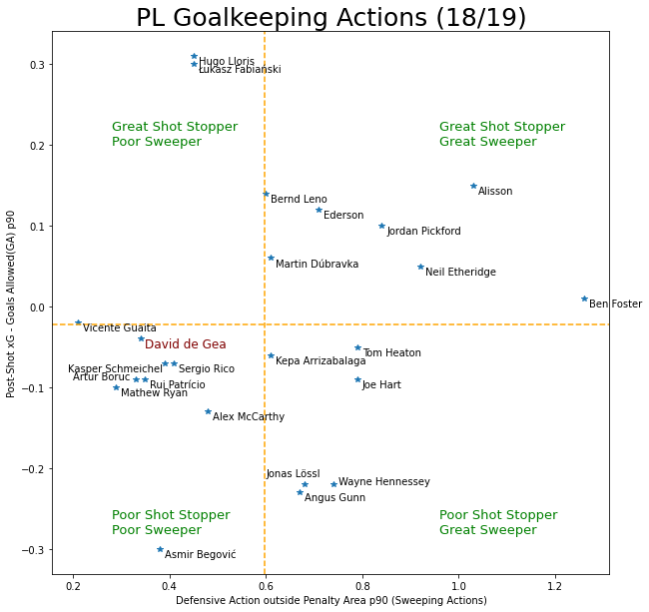
2018-2019
GOALKEEPING
The season saw the decline of David De Gea. As his stop-stopping ability declined significantly and leaked a lot scrappy goals at times

Slide 53
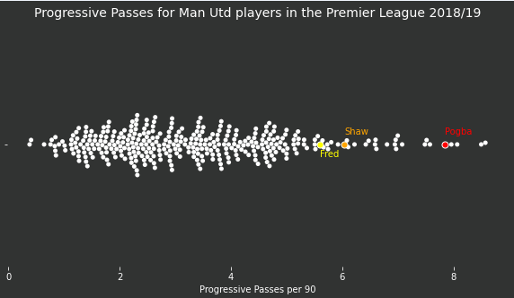
2018-2019
Progressive Passing
Pogba (7.84) saw his resurgence under Solskjaer being best progressive passer at Utd and 5th best in the league. Shaw and Matic finsihed behind him with 6.04 and 5.31 passes/90 resp.

Slide 54
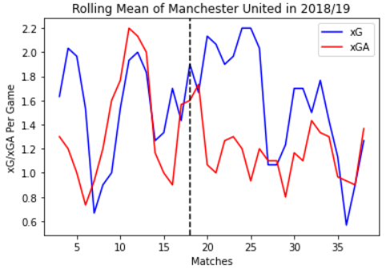
2018-2019
Rolling Mean- xG v xGA
The decline under Jose Mourinho was quite apparent. The dotted line is when Ole Gunnar Solskjaer was appointed as caretaker manager and that coincided with United resurgence - Registering rolling mean xG as high as 2.2 and bringing down the xGA to 1 ,United had turned the tables around. Injuries and fitness among some important players plagued United in the last 10 games which was quite apparent as the xG dropped significantly and xGA rose sharply again.

Slide 55
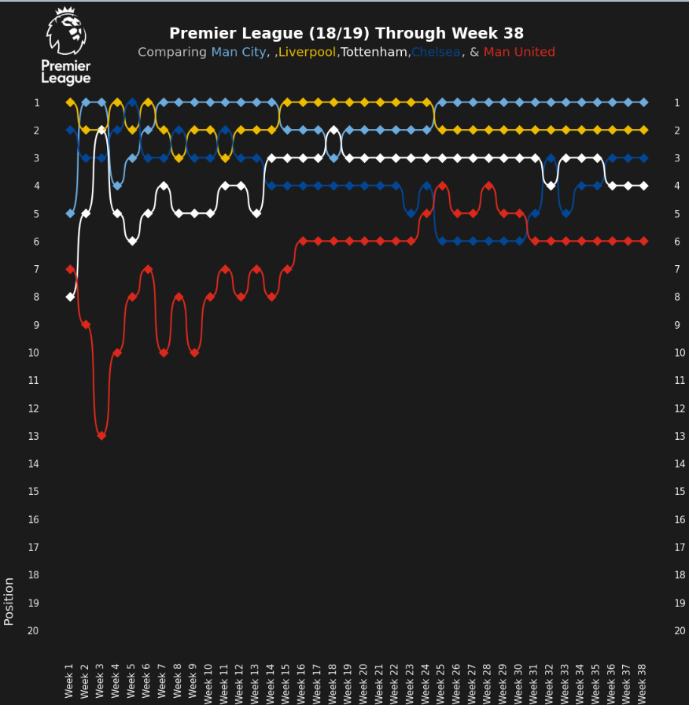
2018-2019
STANDINGS PER MATCHWEEK
Jose Mourinho oversaw a bad start at United before he was free of his duty after the 14th game. Ole Gunnar Solskjaer took over and Man Utd stormed into top 4 by the 25th game. A decline followed thanks to injuries to some important players and Utd eventually finished 6th
l

Slide 56
2019-2020: The Cultural Reboot

Slide 57

2019-2020
Squad
Transfer IN Transfer OUT
Harry Maguire Chris Smalling (loan)
Aaron Wan Bissaka Alexis Sanchez (loan)
Daniel James Ander Herrera
Bruno Fernandes(Jan) Marcos Rojo
Odion Ighalo(Jan loan) Ashley Young
Romelu Lukaku
Chris Smalling (loan)
The Norwegian legend oversaw a massive exodus of senior players who were in their early 30s and brought in young players in their mid 20s and promoted youngsters like Mason Greenwood(18) from the academy to play fresh brand of quick attacking football. The preferred formation was 4-2-3-1.

Slide 58

2019-2020
SHOTS
Man Utd showed steady improvement in most of the fields. The addition of young blood helped them top the charts for Distance Covered metric,
l

Slide 59

2019-2020
PASSING
Man Utd’s lack of creativity during the first half of the season before the arrival of Bruno Fernandes is clearly noticeable here. Crosses into the box to break down the opposition has reduced drastically as they shifted into playing quick short passes/carrying the ball into the 18 yrd box
l

Slide 60

2019-2020
GOALKEEPING
De Gea decline continued and his shotstopping ability was just slightly above average. As United didn’t employ a high line yet it still made his case well.
l

Slide 61

2019-2020
Progressive Passing
Pogba recorded league’s highest prog passes/90 with 8.13. Meanwhile new Jan signing Bruno and Young registered 6.06 and 5.94 progessive passes/90 resp.

Slide 62

2019-2020
Rolling Mean
The rolling mean of size 3 (3 games) was taken into account and result seemed far better and consistent than the previous season. As Solskjaer’s proactive counterattack approach meant Man Utd didn’t concede a lot of goals and were efficient defensively

Slide 63

2019-2020
STANDINGS PER MATCHWEEK
Utd had a shaky start to the season and were 9th after 9 games into the season but they steadily recovered and signing of Bruno Fernandes after Burnley home game (18th match of the season) had an instant impact on United that saw them rise up the table to eventually finish 3rd just above rivals Chelsea

Slide 64
2020-2021

Slide 65

2020-2021
Squad
Transfer IN Transfer OUT
Donny Van de Beek Chris Smalling
Alex Telles Alexis Sanchez
Edinson Cavani Diogo Dalot(loan)
Amad Diallo Marcos Rojo
Facundo Pellestri Andrea Pereira(loan)
Odion Ighalo
United had a relatively quite summer as they looked to clear out fringe players and bring in additional players to increase their bench strength. The average age of squad jumped to 26 thanks to the addition of few veteran players like Edinson Cavani (33) and Alex Telles (27). The cultural reboot was in full flow

Slide 66

2020-2021
SHOTS
Man Utd’s shooting quality improved massively in this season. They were in the outer ring for each and every stat except npXG and npXG/Sh. They topped the SOT% metric. The progress was quite evident.
l

Slide 67

2020-2021
PASSING
Man Utd’s passing quality showed slight improvement than previous season. After failing to make not only one attribute in outer most ring, Utd were able to register 3 attributes this time around for Ast, A - xA and Pass to Shots.
l

Slide 68

2020-2021
GOALKEEPING
De Gea and Dean Henderson went head to head for the No.1 spot. As expected DDG’s shot-stopping declined continued and Henderson sweeping + decent shot-stopping ability helped him pip his counterpath for the No.1 spot
l

Slide 69

2020-2021
Progressive Passing
Bruno Fernandes continued his fine time at United registering 6.59 prog passes/90. Meanwhile Pogba and Shaw registered 5.26 and 5.22 progessive passes/90 resp.

Slide 70

2020-2021
xG v xGA
Man Utd had a rough start to season as they conceded 11 goals and scored only 5 goals in first three
games but the resurrected themselves and sustained the xG throughout the season. The big wins
vs Newcastle(4-1), Leeds (6-1) and Southampton (9-0) led to the peaks in xG from time to time

Slide 71

2020-2021
STANDINGS PER MATCHWEEK
This shows how United had a bad start to the season but quicky recovered and climbed to the top spot by 17th game before being pipped out of by eventual winners Man City to hold on to be the runners ups of the season.
l

Slide 72


2020-2021
PIE CHART
Harry Maguire and Victor Lindelof played a crucial rolr for United with Maguire being massively dominant in ball
progression while Lindelof acted as a sweeper. Maguire’s aerial prowess helped complement Lindelof’s
weakness with it

Slide 73

CONCLUSION
Ole Gunnar Solskjaer’s has helped resurrect Manchester United and their fortunes.
They have shown steady signs of improvement under him
The 21/22 summer window will be really key to decide where the project is headed to.

